Slide 1
Unit 13 Naïve Bayes
Machine Learning

Slide 2
Naïve Bayes Classifier Algorithm
Naïve Bayes algorithm is a supervised learning algorithm, which is based on Bayes theorem and used for solving classification problems.
It is mainly used in text classification that includes a high-dimensional training dataset.
Naïve Bayes Classifier is one of the simple and most effective Classification algorithms which helps in building the fast machine learning models that can make quick predictions.

Slide 3
Naïve Bayes Classifier Algorithm
It is a probabilistic classifier, which means it predicts on the basis of the probability of an object.
Some popular examples of Naïve Bayes Algorithm are spam filtration, Sentimental analysis, and classifying articles.

Slide 4
Why is it called Naïve Bayes?
The Naïve Bayes algorithm is comprised of two words Naïve and Bayes, Which can be described as:
  Naïve: It is called Naïve because it assumes that the occurrence of a certain feature is independent of the occurrence of other features.
  Such as if the fruit is identified on the bases of color, shape, and taste, then red, spherical, and sweet fruit is recognized as an apple.
Notes:
Naïve: It is called Naïve because it assumes that the occurrence of a certain feature is independent of the occurrence of other features. Such as if the fruit is identified on the bases of color, shape, and taste, then red, spherical, and sweet fruit is recognized as an apple. Hence each feature individually contributes to identify that it is an apple without depending on each other.

Slide 5
Why is it called Naïve Bayes?
The Naïve Bayes algorithm is comprised of two words Naïve and Bayes, Which can be described as:
  Hence each feature individually contributes to identify that it is an apple without depending on each other.
Bayes: It is called Bayes because it depends on the principle of Bayes' Theorem.
Notes:
Naïve: It is called Naïve because it assumes that the occurrence of a certain feature is independent of the occurrence of other features. Such as if the fruit is identified on the bases of color, shape, and taste, then red, spherical, and sweet fruit is recognized as an apple. Hence each feature individually contributes to identify that it is an apple without depending on each other.

Slide 6

Bayes' Theorem
Bayes' theorem is also known as Bayes' Rule or Bayes' law, which is used to determine the probability of a hypothesis with prior knowledge.
P(A|B) is Posterior Probability of hypothesis A on the observed event B.
P(B|A) is Likelihood probability of the evidence given that the probability of a hypothesis is true.
P(A) is Prior Probability of hypothesis before observing the evidence.
P(B) is Marginal Probability of Evidence.

Slide 7
Working of Naïve Bayes' Classifier
Working of Naïve Bayes' Classifier can be understood with the help of the below example.
Suppose we have a dataset of weather conditions and corresponding target variable "Play".
So using this dataset we need to decide that whether we should play or not on a particular day according to the weather conditions.

Slide 8
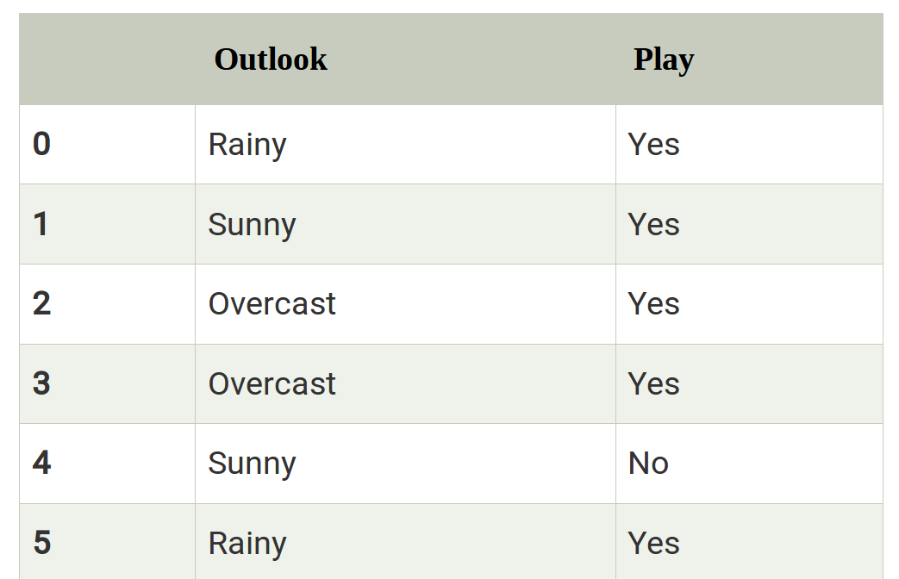
Working of Naïve Bayes' Classifier
Problem: If the weather is sunny, then the Player should play or not?
Solution: To solve this, first consider the below dataset with 14 records:

Slide 9
Working of Naïve Bayes' Classifier
So to solve this problem, we need to follow the below steps:
  Convert the given dataset into frequency tables.
  Generate Likelihood table by finding the probabilities of given features.
  Now, use Bayes theorem to calculate the posterior probability.

Slide 10
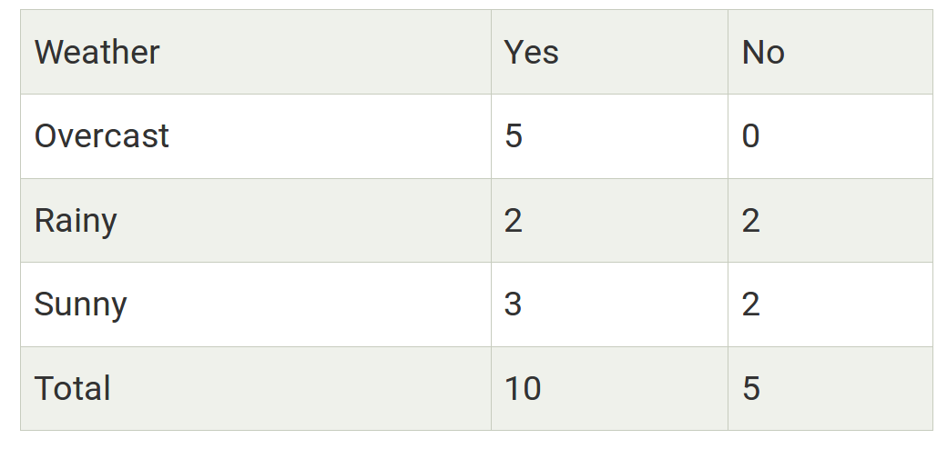
Working of Naïve Bayes' Classifier
Frequency table for the Weather Conditions:

Slide 11
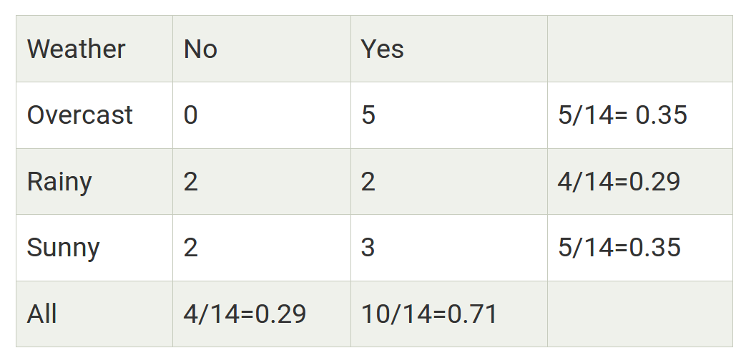
Working of Naïve Bayes' Classifier
Likelihood table weather condition:

Slide 12
Working of Naïve Bayes' Classifier
Applying Bayes'theorem:
  P(Yes|Sunny)= P(Sunny|Yes)*P(Yes)/P(Sunny)
  P(Sunny|Yes)= 3/10= 0.3
  P(Sunny)= 0.35
  P(Yes)=0.71
  So P(Yes|Sunny) = 0.3*0.71/0.35= 0.60

Slide 13
Working of Naïve Bayes' Classifier
Applying Bayes'theorem:
  P(No|Sunny)= P(Sunny|No)*P(No)/P(Sunny)
  P(Sunny|NO)= 2/4=0.5
  P(No)= 0.29
  P(Sunny)= 0.35
  So P(No|Sunny)= 0.5*0.29/0.35 = 0.41
So as we can see from the above calculation that P(Yes|Sunny) = 0.60 > P(No|Sunny = 0.41)
Hence on a Sunny day, Player can play the game.

Slide 14
Advantages of Naïve Bayes Classifier
Naïve Bayes is one of the fast and easy ML algorithms to predict a class of datasets.
It can be used for Binary as well as Multi-class Classifications.
It performs well in Multi-class predictions as compared to the other Algorithms.
It is the most popular choice for text classification problems.

Slide 15
Disadvantages of Naïve Bayes Classifier
Naive Bayes assumes that all features are independent or unrelated
So it cannot learn the relationship between features.

Slide 16
Applications of Naïve Bayes Classifier
It is used for Credit Scoring.
It is used in medical data classification.
It can be used in real-time predictions because Naïve Bayes Classifier is an eager learner.
It is used in Text classification such as Spam filtering and Sentiment analysis.
https://www.javatpoint.com/machine-learning-naive-bayes-classifier

Slide 17
Types of Naïve Bayes Model
There are three types of Naive Bayes Model, which are given below:
  Gaussian: The Gaussian model assumes that features follow a normal distribution.
  This means if predictors take continuous values instead of discrete, then the model assumes that these values are sampled from the Gaussian distribution.

Slide 18
Types of Naïve Bayes Model
  Multinomial: The Multinomial Naïve Bayes classifier is used when the data is multinomial distributed.
  It is primarily used for document classification problems, it means a particular document belongs to which category such as Sports, Politics, education, etc.
  The classifier uses the frequency of words for the predictors.

Slide 19
Types of Naïve Bayes Model
  Bernoulli: The Bernoulli classifier works similar to the Multinomial classifier, but the predictor variables are the independent
  Booleans variables. Such as if a particular word is present or not in a document.
  This model is also famous for document classification tasks.
https://www.javatpoint.com/machine-learning-naive-bayes-classifier

Slide 20
Lab
https://www.javatpoint.com/machine-learning-naive-bayes-classifier

